Slide 1


RAECC-2025
National Conference
on
Recent Advancements in Electronics, Communication and Computing
15-16 April, 2025
Organized by
In Association with
Paper Title: Revolutionizing Tumor Detection with Hybrid Deep Learning Models Integrating MRI and CT Modalities
Paper ID:09
Presented by: Manohar Kumar Sah & Prakash Sahoo
Mentor : Purabi Chanda
Name of College/Organization: GIFT BBSR
RAECC-2025@GIFT Paper ID-09

Slide 2

Contents
Introduction
Literature Review
Proposed Methodology
Conclusion and Future Work
Motivation/Problem Statement
Objective
Results and Discussion
RAECC-2025 Paper ID-09

Slide 3
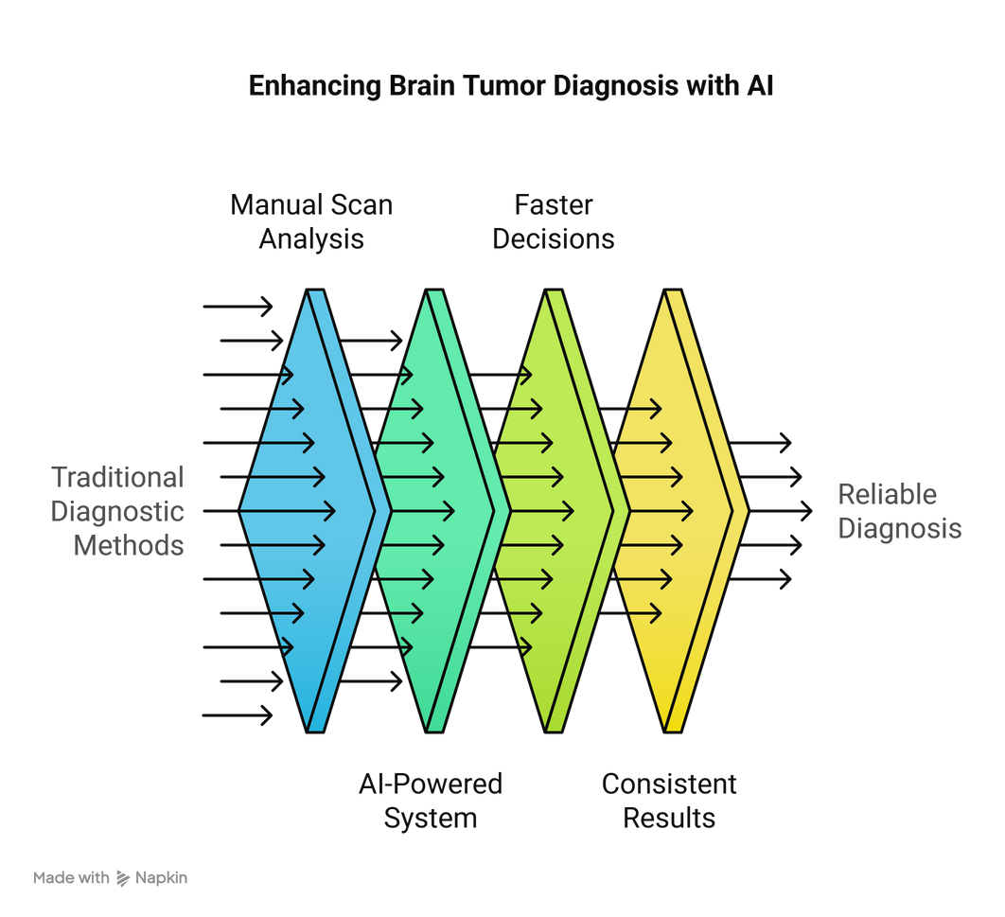
Introduction
Brain tumors pose serious health risks, making early and accurate detection vital for effective treatment.
Traditional diagnostic methods rely heavily on manual analysis of MRI and CT scans, which can be:
Time-consuming
Subjective and prone to inter-observer variability
The goal is to develop an AI-powered system that automates:
Segmentation of tumors in MRI scans
Classification of tumors in CT scans
This helps radiologists make faster, more consistent, and reliable decisions.
RAECC-2025 Paper ID-09

Slide 4
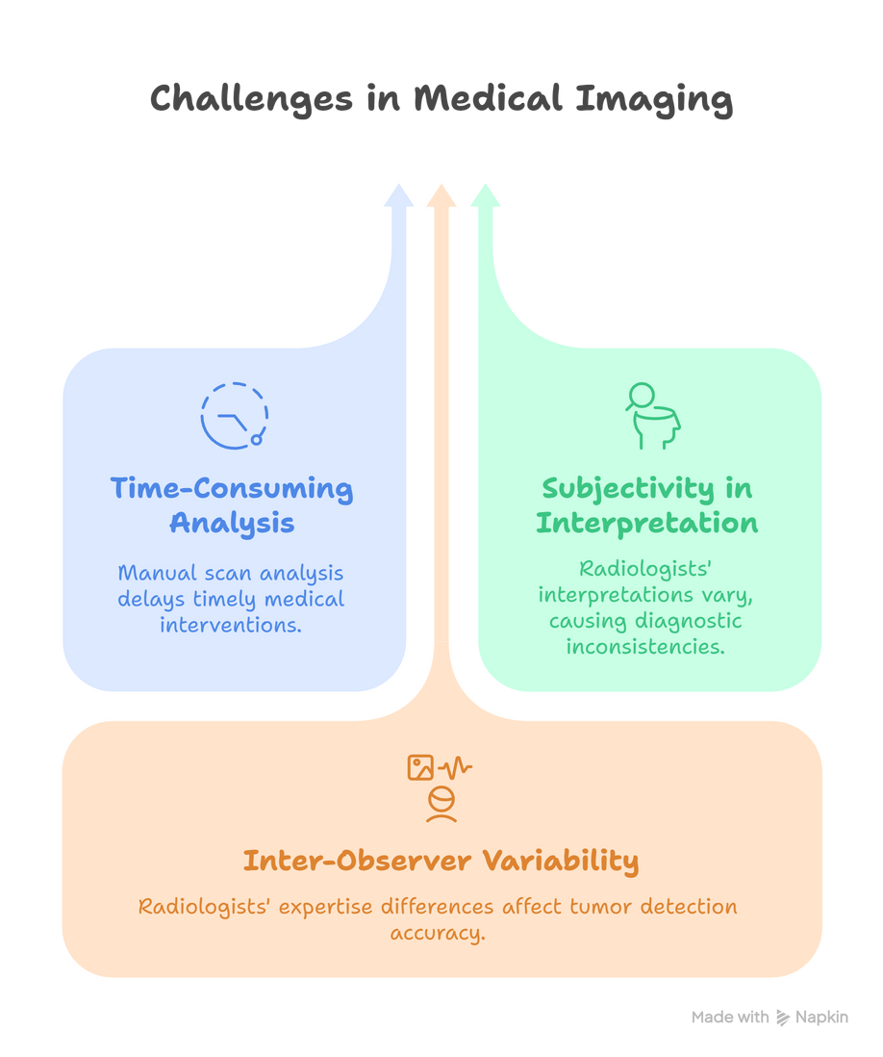
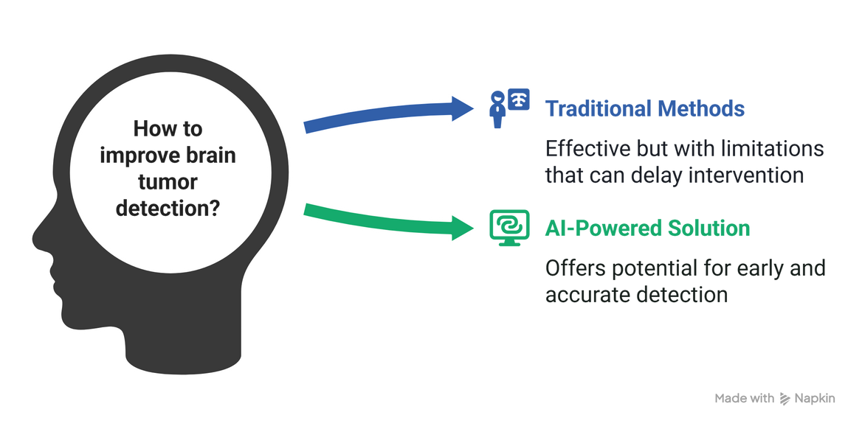
Motivation/Problem Statement
Brain tumors pose serious health risks, making early and accurate detection vital for effective treatment. The conventional diagnostic methods, while effective, have significant limitations that can hinder timely intervention. This document outlines the challenges faced in traditional diagnostic approaches and presents a solution leveraging artificial intelligence.
RAECC-2025 Paper ID-09

Slide 5
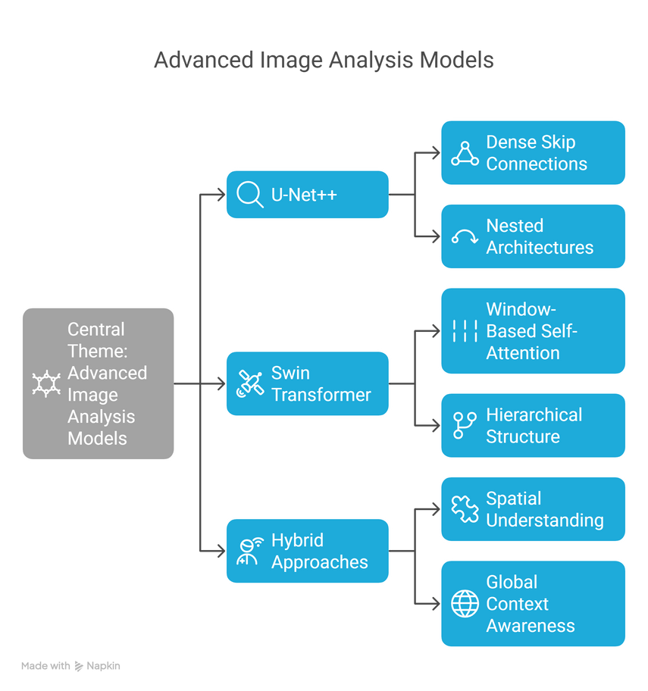
Literature Review
Deep learning has advanced image segmentation and classification. U-Net++ is effective for segmentation, while Swin Transformer excels in classification. However, hybrid models combining both are rarely explored.
U-Net++:
An improved U-Net with dense skip connections, offering better feature learning and pixel-level accuracy, especially for medical image segmentation.
Swin Transformer:
Uses window-based self-attention to capture local and global features, outperforming CNNs in classification tasks.
Hybrid Approaches:
Few studies combine U-Net++ and Swin Transformer. Such hybrids could enhance multi-task vision tasks by merging precise segmentation with strong contextual understanding.
Research Gap
Lack of dual-modality models for diagnosis.
Limited adoption of Transformers in medical imaging.
No unified system for MRI segmentation + CT classification.
RAECC-2025 Paper ID-09

Slide 6
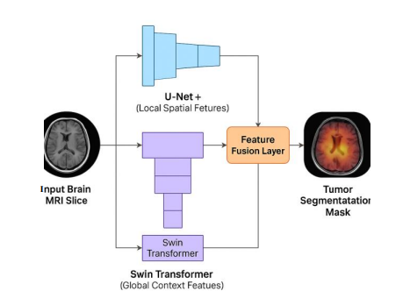

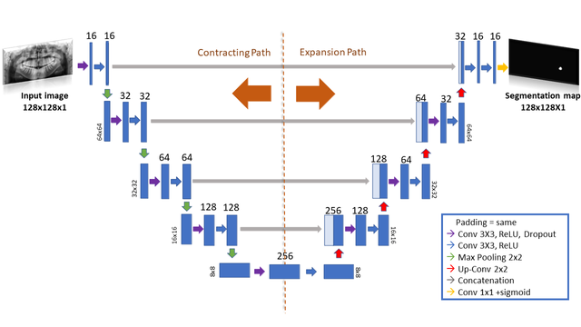
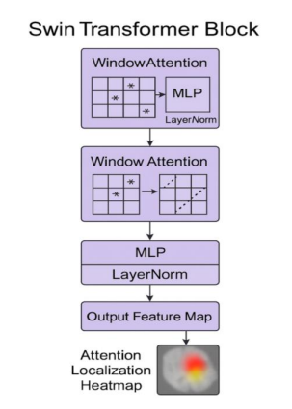
Objective
The objective of this study is to develop a hybrid deep learning framework that combines U-Net++ and Swin Transformer for improved medical image analysis. U-Net++ will be used to accurately segment tumors from MRI scans, while the Swin Transformer will classify CT scan images. The system will integrate both models to form a hybrid decision mechanism that leverages the strengths of segmentation and classification. The final aim is to evaluate the performance and interpretability of the hybrid model in comparison to individual approaches.
Hybrid Model
Swim Transformer
Unet++
RAECC-2025 Paper ID-09

Slide 7
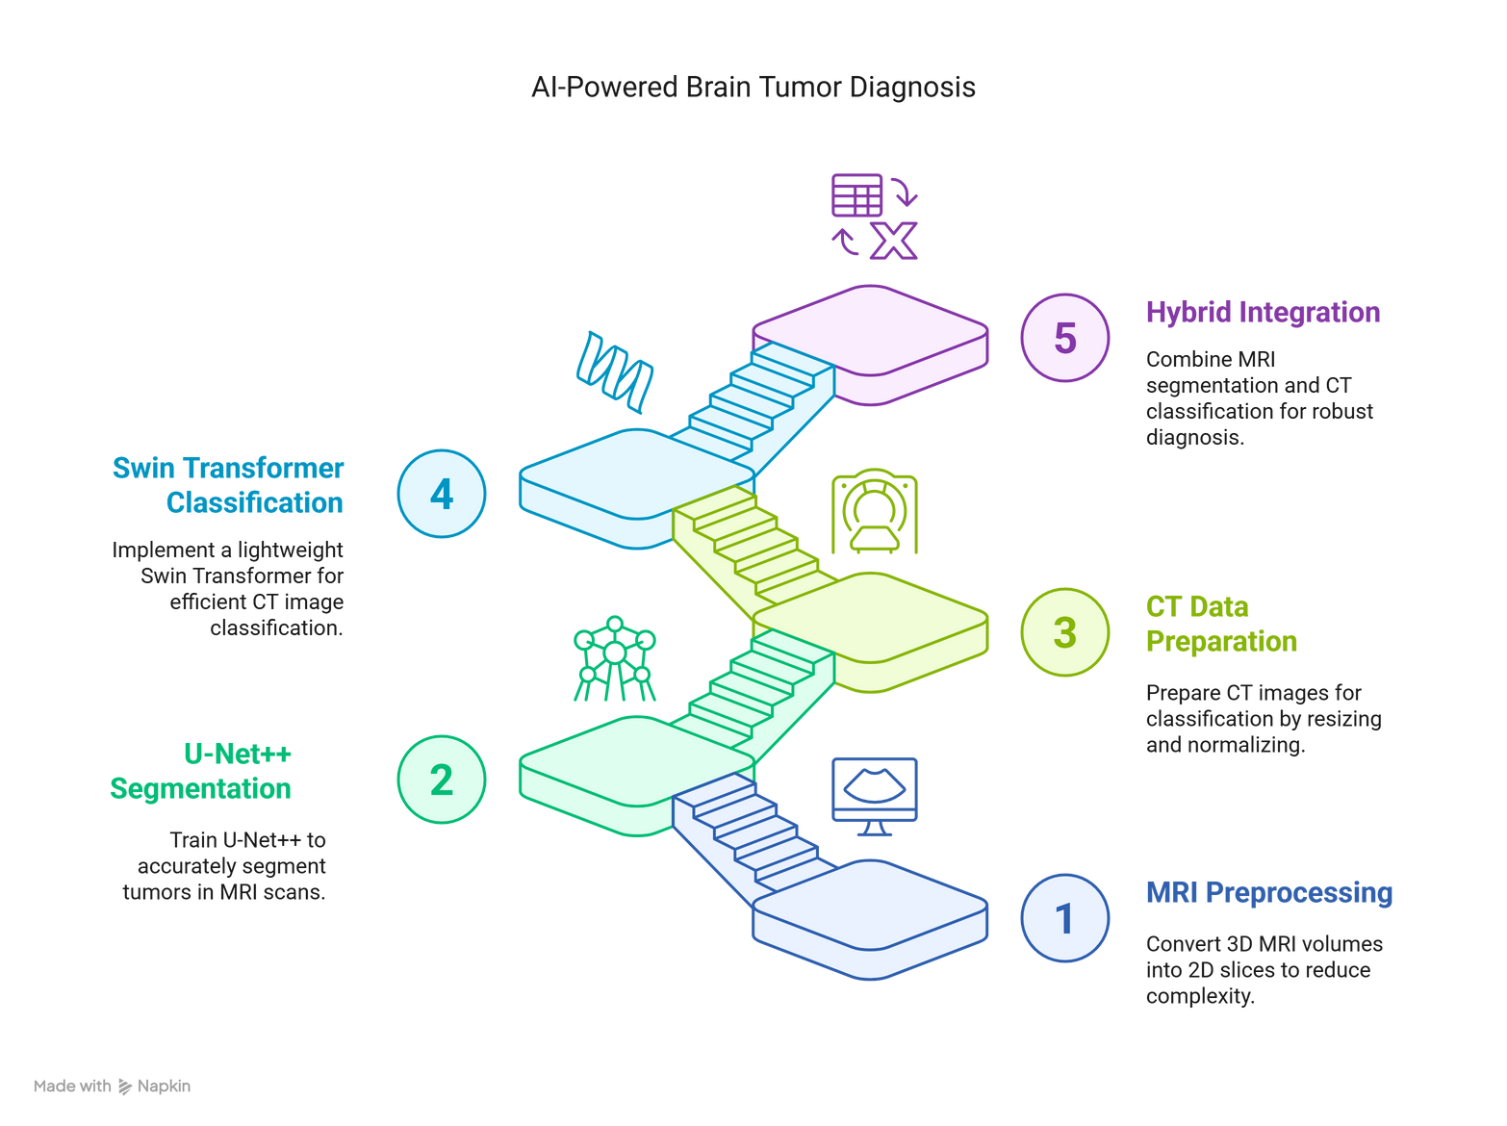
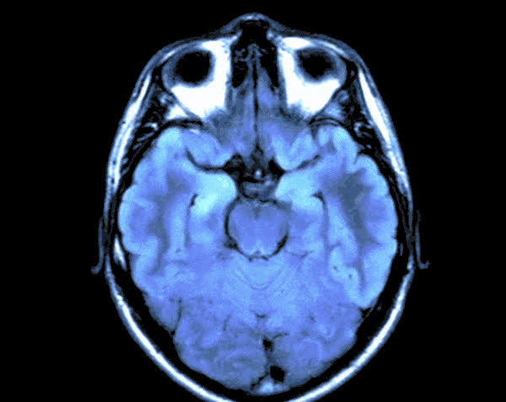
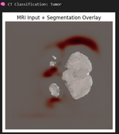
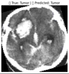
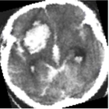
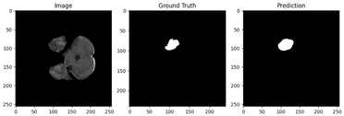
Proposed Methodology
RAECC-2025 Paper ID-09

Slide 8
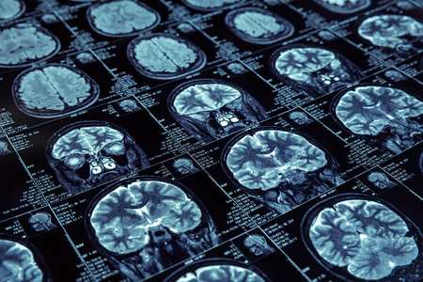
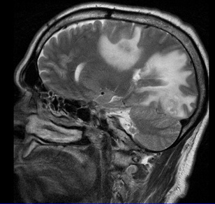
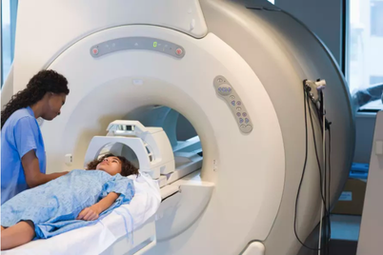
Dataset Description
MRI Dataset: BraTS 2020 (Segmentation + Mask).
CT Dataset: Binary Classification (Healthy vs Tumor).
MRI slices used: ~11,000 | CT Images: 2,000+.
RAECC-2025 Paper ID-09

Slide 9
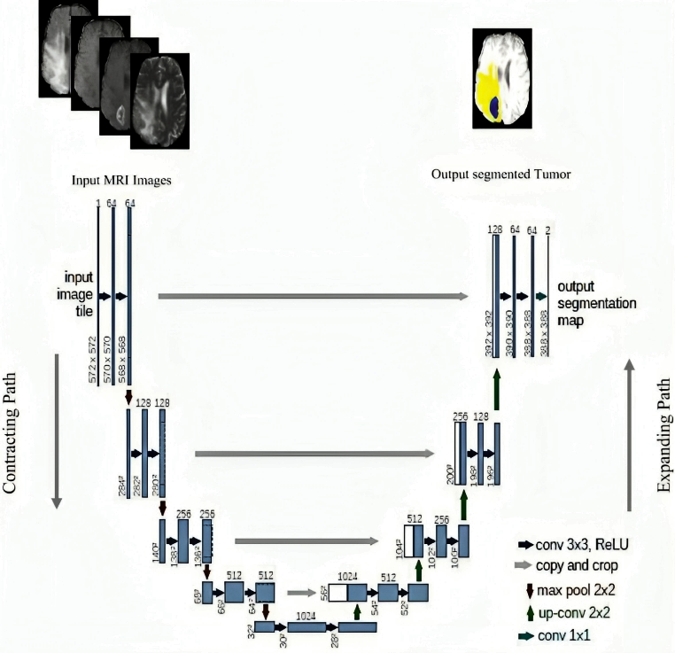
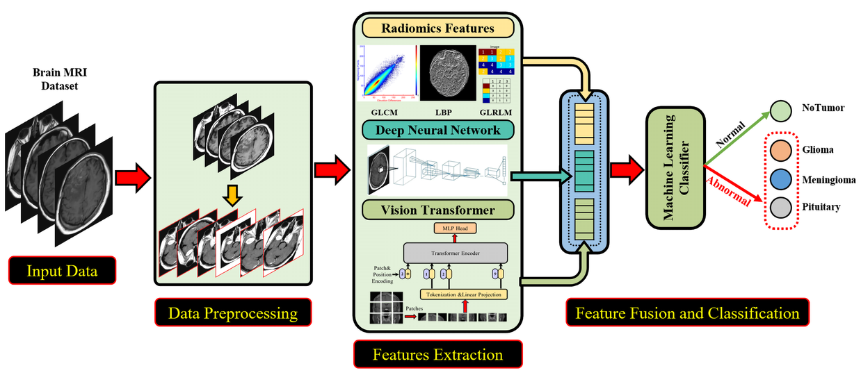
Model Architectures
Swim Transformer
U –Net++
RAECC-2025 Paper ID-09

Slide 10
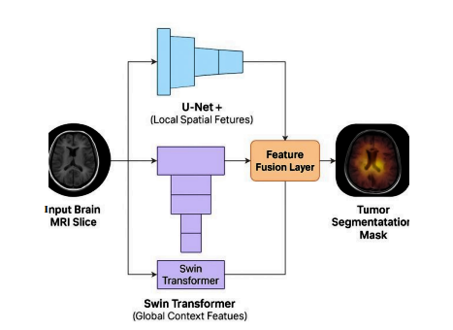
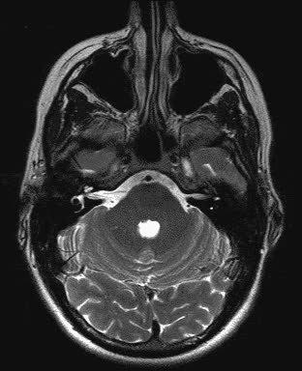
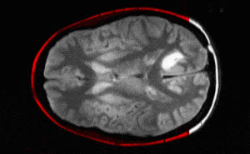
Hybrid Approach
The hybrid model integrates U-Net++ for precise MRI-based tumor segmentation and a Swin Transformer for CT scan classification. By combining spatial segmentation with global contextual classification, it enhances diagnostic reliability and leverages the strengths of both imaging modalities.
RAECC-2025 Paper ID-09

Slide 11
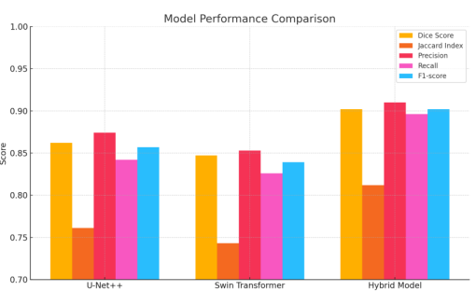
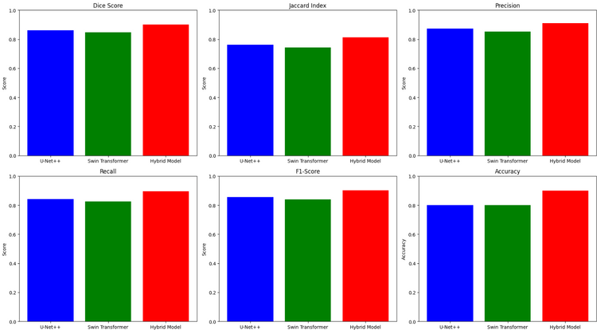
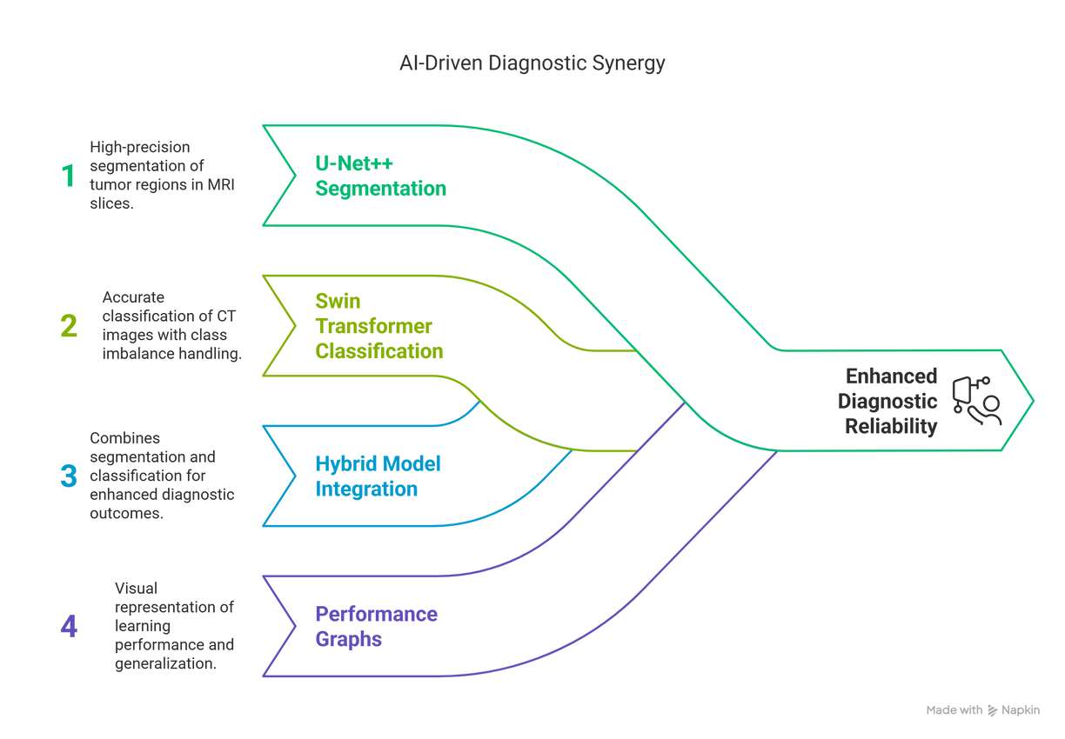
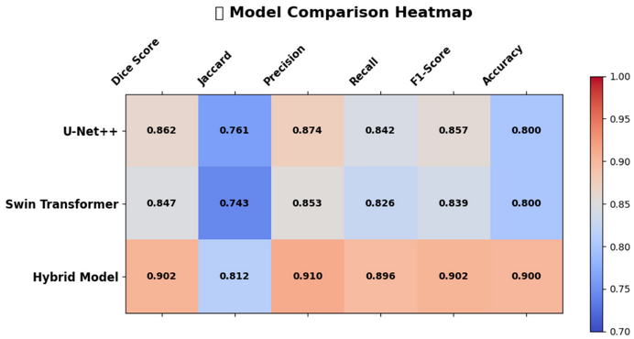
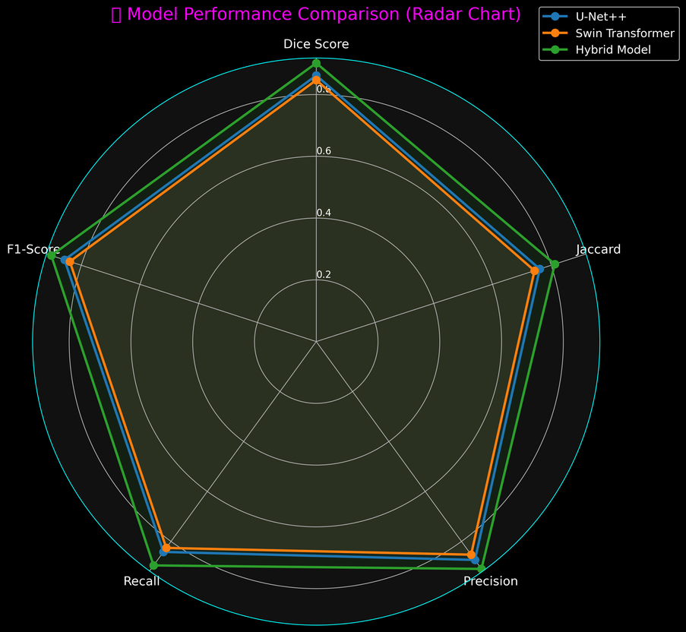
Results and Discussion
RAECC-2025 Paper ID-09

Slide 12
Conclusion and Future Work
Conclusion
This work presents a hybrid AI-based framework combining U-Net++ for MRI segmentation and Swin Transformer for CT classification.
The models achieved reliable performance in detecting and identifying brain tumors across both modalities.
The approach supports radiologists by offering faster, consistent, and interpretable results, aiding in early diagnosis.
Future Work
Extend segmentation to 3D volumes for better spatial context.
Test on larger, multi-institutional datasets for real-world robustness.
Integrate explainability techniques (e.g., Grad-CAM) to enhance clinical trust.
Build a unified end-to-end interface for clinical usage.
RAECC-2025 Paper ID-09

Slide 13




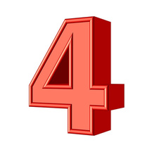

References
Zhou et al., “UNet++: A Nested U-Net Architecture for Medical Image Segmentation”, DLMIA 2018.
Liu et al., “Swin Transformer: Hierarchical Vision Transformer Using Shifted Windows”, ICCV 2021.
BraTS 2020 Brain Tumor MRI Dataset.
Kaggle: Brain Tumor CT Dataset (Healthy & Tumor).
Related segmentation/classification papers reviewed during methodology design.
RAECC-2025 Paper ID-09

